Slide 1
KrishiMitra : Using IoT for Direct Farm-to-Consumer Sales with Quality-Based Pricing
PIP2001 University Project
Viva voce
Batch Number: CIT-G32
Name | Roll Number
20211CIT0180 | NARATI TEJA
20211CIT0084 | SOMU CHAITANYA KUMAR REDDY
20211CIT0022 | CHAPARALA JAYAPRAKASH
20211CIT0024 | TAGARAMPUDI VEERABHADRA SWAMYNADH
20211CIT0010 | JAMPULA VISHNUVARDHAN
Under the Supervision of,
Dr. N. Syed Siraj Ahmed
Associate Professor(selection grade).
School of Computer Science & Engineering
Presidency University

Slide 2
Introduction
The agricultural sector is plagued by a range of issues that negatively impact both farmers and consumers. Key challenges include inefficiencies in the distribution system, price volatility, and significant quality loss due to poor storage and handling practices. Traditional models involving intermediaries reduce the profitability for farmers and compromise the freshness and quality of produce reaching the consumers.
KrishiMitra offers a solution by leveraging Internet of Things (IoT) technologies to create a streamlined sales process. This platform facilitates direct farm-to-consumer sales, ensuring quality-based pricing through real-time data collection. By removing intermediaries, KrishiMitra not only improves profitability for farmers but also enhances consumer trust through transparent pricing and quality assurance.

Slide 3
Literature Review
This paper titled "Research on the Development of E-commerce Model of Agricultural Products" by Jaswanth Reddy Vulchi deals with a very evolving area of agricultural e-commerce. The significance of e-commerce in elevating the sales and circulation of agricultural products is presented with a large growth in sales and participants in such platforms as Alibaba. It analyzes a few notable e-commerce models, such as Tootoo Industrial Commune, Original Life, and Suichang Model, with the product-driven, marketing-driven, and service platform-driven e-commerce models respectively. It talks about the framework of their operations, strengths, and weaknesses on seven dimensions such as logistics, quality standards, government support, etc. The authors detect gaps in quality control, farmer engagement, and government intervention from such comparisons. They provide practical advice to farmers, e-commerce companies, and policy makers to improve the quality, availability, and governance of agricultural products in China. The paper explains that e-commerce is very viable in terms of income improvement for farmers, satisfaction of consumers' demands, and establishment of efficient supply chains.

Slide 4
Literature Review
The paper, "Key Factors in Forming an E-Marketplace: An Empirical Analysis," is focused on the enhancement of efficiency in Taiwan's floral industry based on the adoption of mechanisms of e-commerce. Its focus is on the literature survey concerning the problems of traditional wholesale markets due to low service quality and problems associated with collecting price information. It identifies the potential of e-marketplaces in enhancing trading efficiency, reducing costs, and simplifying operations for suppliers and retailers. Works done by Ratchford et al. and O'Keefe and Loebbecke have demonstrated that the Internet may have potential utility for other industries for efficient information dissemination, so do not apply virtual solutions unless and until the market preferences have been understood.

Slide 5
Literature Review
The developed work applies advanced decision techniques, such as Fuzzy Delphi and Fuzzy Multiple Criteria Decision Making in the identification of critical factors which include order accuracy, processing efficiency, and collaboration of urgent orders. The insights are combined with cooperation modes like joint price negotiations and active order placement to propose an adaptive operational framework. Taking into account empirical analysis, it extends existing e-commerce study and provides actionable strategies regarding the development of an efficient online marketplace for Taiwan's floral business.

Slide 6
System Architecture

Slide 7
Objectives
The primary objective of KrishiMitra is to create a transparent and efficient agricultural supply chain by leveraging IoT technology. The platform aims to empower farmers by enabling direct farm-to-consumer sales, thereby eliminating intermediaries and ensuring that farmers receive a fair share of the sales price. This direct sales model not only increases farmers' profit margins but also boosts consumer confidence by providing fresh, high-quality produce at fair prices.
Another key objective is to implement real-time dynamic pricing based on the quality of produce. By integrating IoT sensors, KrishiMitra continuously monitors various quality parameters such as gas emissions, color consistency, and moisture content. This data feeds into a dynamic pricing algorithm that adjusts prices according to real-time quality assessments, ensuring that consumers pay a fair price reflecting the actual value of the produce. Additionally, the platform seeks to enhance sustainability by reducing food waste and optimizing resource usage through continuous quality monitoring and timely interventions.

Slide 8
IoT Sensor Integration
KrishiMitra employs three key IoT sensors: the MQ-135 gas sensor, TCS3200 color sensor, and a capacitive moisture sensor. The MQ-135 detects spoilage gases, such as carbon dioxide and ammonia, which are critical indicators of produce freshness and quality. This helps in early detection of spoilage, allowing farmers to take timely action.
The TCS3200 color sensor monitors color consistency, providing insights into the ripeness and quality of produce. This is particularly useful for sorting and quality control. The capacitive moisture sensor measures moisture content, a crucial factor for maintaining product freshness and preventing spoilage. Together, these sensors provide a comprehensive quality assessment that supports dynamic pricing and improves product handling.

Slide 9
Methodology
Flow of Methodology:
Farmers → Upload Product Details
Sensors & Arduino → Measure and Process Quality Data
API → Fetch Market Prices
Consumers → Access Marketplace App
Orders → Managed and Fulfilled by Farmers

Slide 10
Dynamic Pricing Algorithm
KrishiMitra’s dynamic pricing algorithm is a key feature that adjusts prices in real-time based on the quality of produce. Data from IoT sensors, such as moisture content, gas emissions, and color consistency, feed into this algorithm to determine the fair market price. High-quality produce commands a premium price, while lower-quality items are priced more affordably.
This transparent pricing model benefits both farmers and consumers. Farmers are incentivized to maintain high-quality standards, as better quality leads to higher prices. Consumers, on the other hand, gain confidence in the pricing mechanism, knowing they are paying a fair price that reflects the true value of the produce they are purchasing.

Slide 11
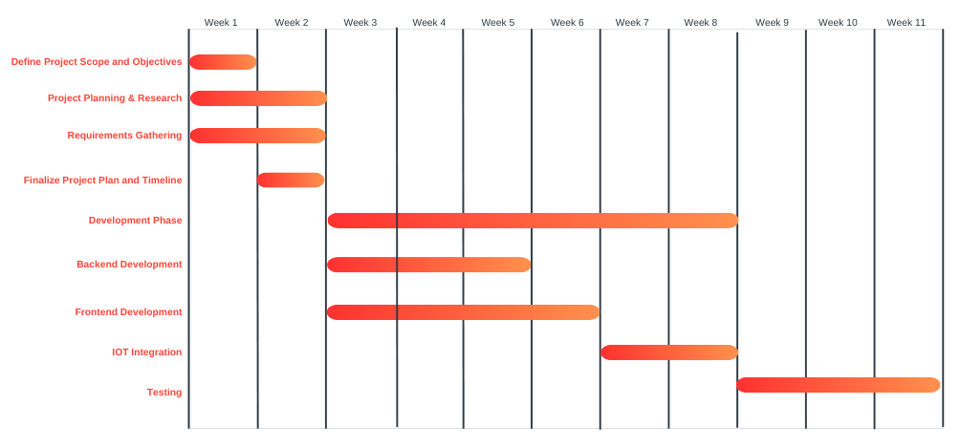
Timeline of Project

Slide 12
Outcomes
The implementation of KrishiMitra has led to significant economic gains for farmers, who now receive a fair share of the sales price without the involvement of middlemen. This increased profitability allows farmers to reinvest in their operations, improving productivity and sustainability. Consumers, on the other hand, benefit from transparent pricing and access to fresh, high-quality produce.
The system’s real-time quality checks ensure that only the best produce reaches the market, enhancing consumer satisfaction and reducing waste. By monitoring conditions such as gas emissions, moisture content, and color consistency, KrishiMitra helps in early detection of spoilage, leading to less waste and fresher products for consumers.

Slide 13
Github Link
The Github link provided should have public access permission.
Github Link

Slide 14
Conclusion
In conclusion, KrishiMitra addresses critical challenges in the agricultural supply chain by leveraging IoT for quality monitoring and dynamic pricing. The platform enhances transparency, improves farmer profitability, and ensures consumer satisfaction. The project has demonstrated significant potential in improving the agricultural sector through innovative technology.
Future work will focus on scaling the system to accommodate more users and integrating advanced predictive analytics to further enhance decision-making. Improvements in user experience and interface design will also be prioritized to ensure the platform remains accessible and user-friendly for all stakeholders.

Slide 15
References
Nagih M. Shaalan,Faheem Ahmed,Osama Saber and Shalendra, Gases in Food Production and Monitoring: Recent Advances in Target Chemi resistive Gas Sensors- Chemo sensors (Volume 10, Issue 8), 2022
MQ135 interfacing with Arduino by NIELIT, Gorakhpur (2020).
Development of Arduino Uno-Based TCS3200 Color Sensor by Muhammad Syukri Surbakti,Muhammad Farhan,Zakaria ,Muhammad Isa (2022).
Dynamic Pricing for Agricultural Produce in E-commerce Models(2021)
Pricing Strategy and Market Platforms for Agricultural Products(2023)
J. Kumar et al: A novel chemiresistive gas sensor for detecting low concentrations of ammonia at room temperature was published in the journal Sensors and Actuators B: Chemical (Volume 350, 2024).

Slide 16
References
A.K. Singh et al.: Monitoring indoor air quality using smart integrated gas sensor module (IGSM) for improving health in COPD patients was published in the journal Environmental Science and Pollution Research International in March 2023.
J. Lee et al: Recent advances in electronic nose technologies employed for sensing food aroma compounds was published in the journal Food Chemistry (Volume 317, 2020).
by X. Li et al: Advancements in Chemiresistive Gas Sensors for Environmental Monitoring: A Comprehensive Review was published in the journal Sensors and Actuators Chemical (Volume 350, 2024)
A.K. Singh et al: Design and Development of a Low-Cost IoT-Based Air Quality Monitoring System was published in the journal Materials Today: Proceedings (Volume 51, Part 1, 2024)

Slide 17
References
The Impact of Online Market Platforms on the Pricing and Marketing of Agricultural Products by M.J. Weiss et al. in Agricultural Economics (2016).
Dr. C. K. Gomathy, V. Jaswanth Reddy, and P. Venkatesh: A Study on Ecommerce Agriculture" was published in 2021
Yaping Huo and Huiping Mu: Research on the Development of E-commerce Model of Agricultural Products" was published in 2017
A survey of electronic nose technologies and applications was published in the journal Sensors and Actuators B: Chemical (Volume 104, Issue 1, 2005)
An Intelligent IoT-Based Food Quality Monitoring Approach Using Low-Cost Sensors" was published in Symmetry in March 2019.
How will the Internet of Things Support Augmented Personalized Health ( Volume: 33, Issue: 1, Jan./Feb. 2018)

Slide 18
Thank You

